Slide 1

Movie Recommendation project
Presented by:-
Guided by:-
Valiveti Manikanta Bhuvanesh-19BCD7088
Tarini Guttula -19BCE7758
Popuri Harsha Vardhan -19BCI7039
G.Balasubramanyam -19BCE7681
Rokkam Anirudh -19BCD7081
Dr.GopiKrishnan

Slide 2
ABSTRACT
If you're a fan of Amazon, Amazon Prime, or Netflix, you're presumably aware that these services use "recommendation engines." As the name implies, the main aim of a recommendation engine is to "propose" relevant things to customers — while Amazon recommends merchandise, Prime and Netflix recommend material to users based on their previous purchase or watch history. This R project's main purpose is to create a recommendation system that will recommend movies to users. We will develop an Item Based Collaborative Filter in this project.

Slide 3
INTRODUCTION

Slide 4
ABOUT DATASET
The dataset used for this project is MovieLens dataset. This data includes 105339 ratings for over 10329 movies.

Slide 5
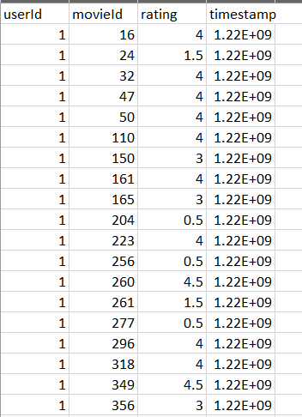
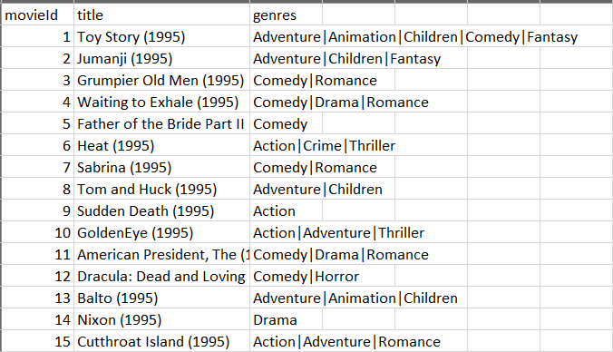
DATASET

Slide 6
PROCEDURE

Slide 7
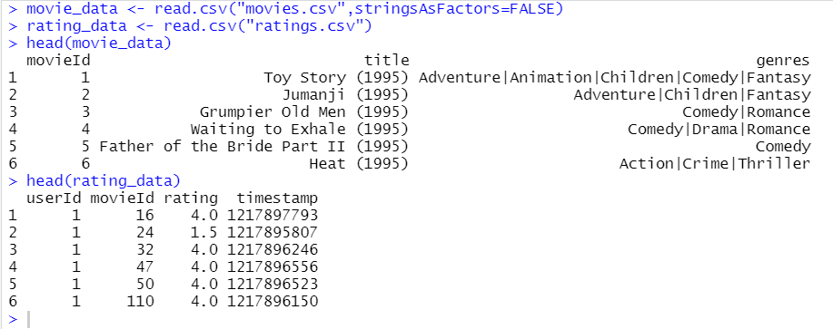
Step1:Loading dataset
We import datasets containing movies and ratings

Slide 8
Step 2 :Data Pre-Processing
We can see that the userId and movieId columns are both made up of numbers. Furthermore, we must change the genres included in the movie data dataframe into a more user-friendly format. To do so, we will first develop a one-hot encoding to generate a matrix of associated genres for each of the films. We constructed a'search matrix' that will allow us to easily search the films in our list by choosing the genre. We must turn our matrix into a sparse matrix in order to receive ratings from recommenderlabs. This new matrix belongs to the'realRatingMatrix' class. Item Based Collaborative Filtering was implemented.

Slide 9
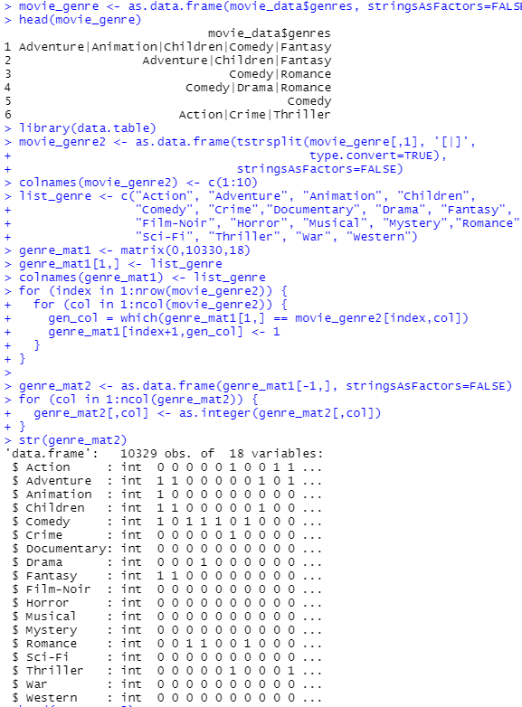
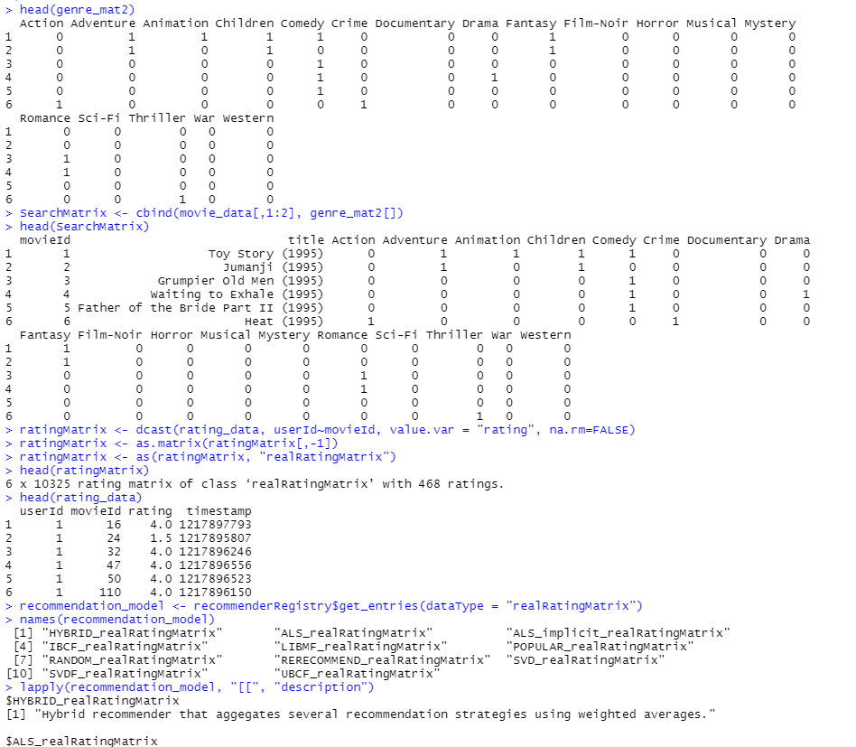

Slide 10
Step 3:Data Exploration
In this step, we are able to discover the information this is contained withinside the datasets. We will use the str() function to display information about the movie_data and rating_data dataframes . We will use summary() function to summarize 2 datasets.

Slide 11
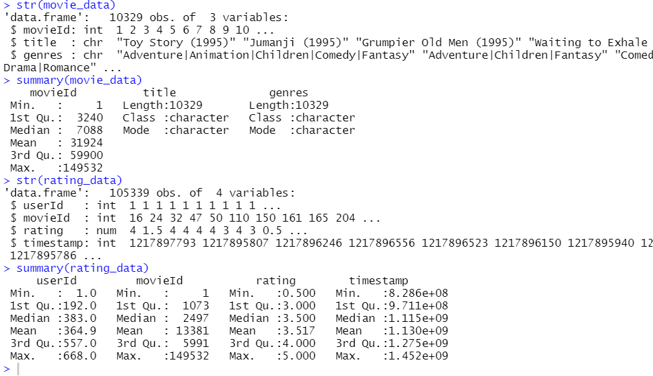

Slide 12
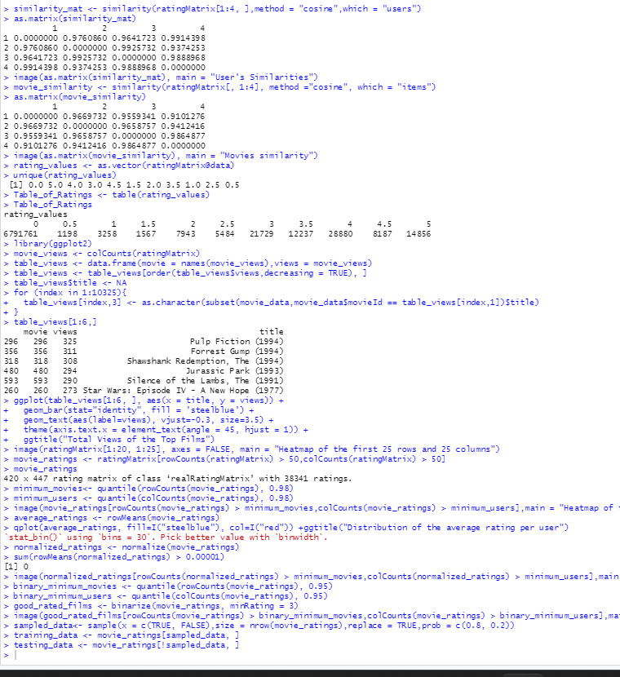
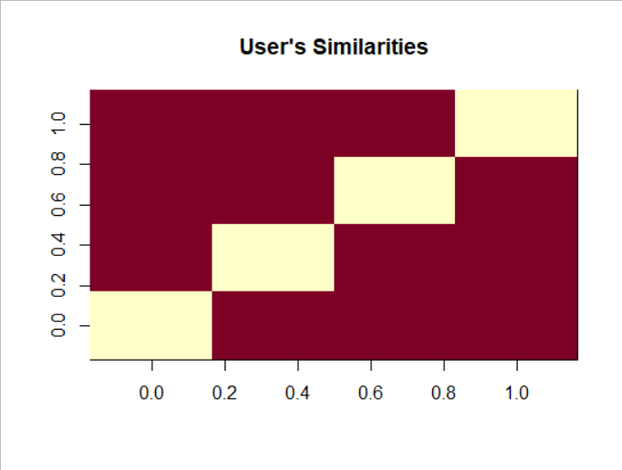

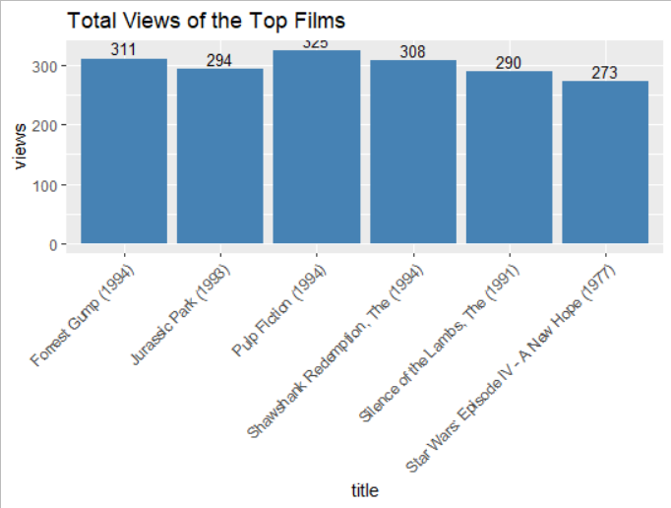
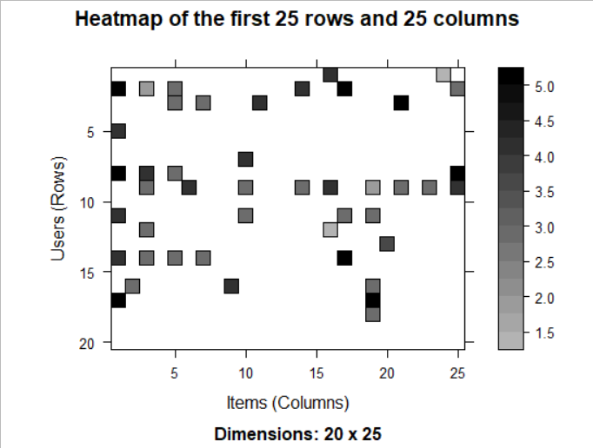
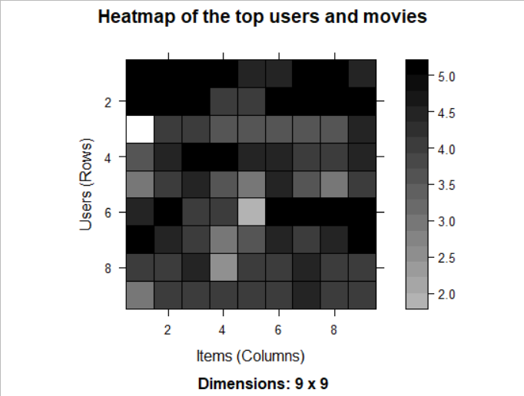
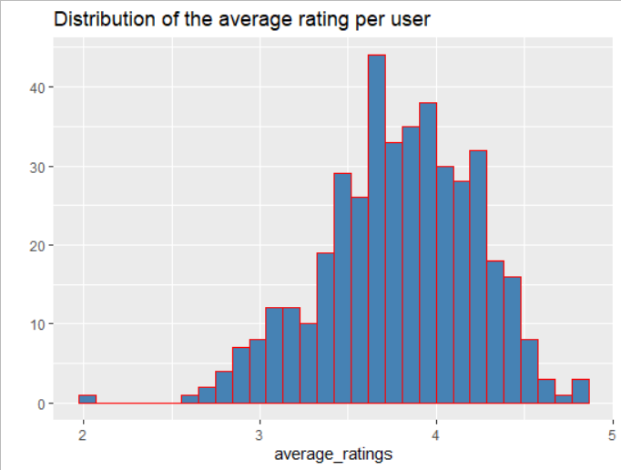

Slide 13
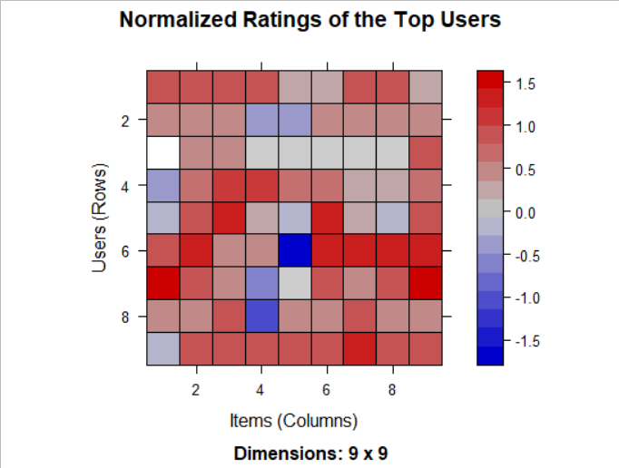
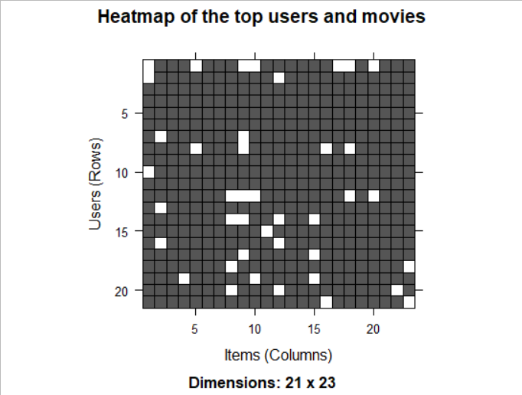

Slide 14
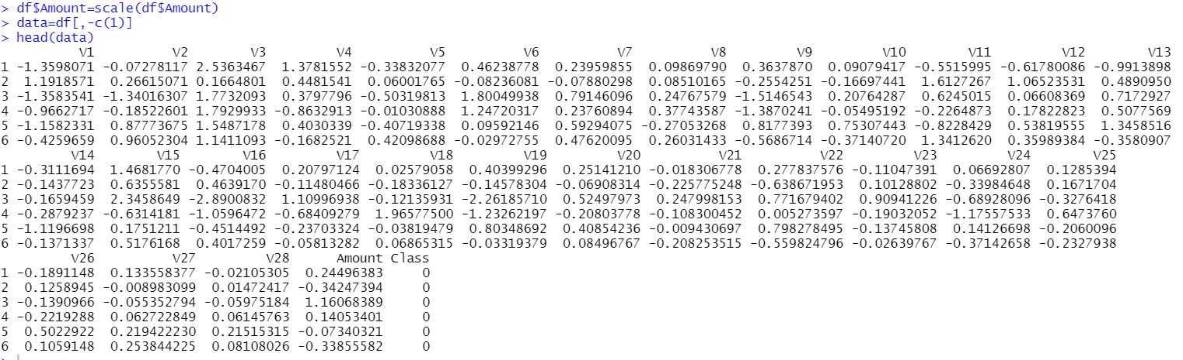

Slide 15
Step 4 :Data Modeling
Once we have standardized the dataset, we will divide our dataset into training sets and test sets with a divide ratio of 0.80. This means that 80% of our data will be attributed to train data while 20% will be attributed to test data.

Slide 16
Build Recommender System
We employ an Item Based Collaborative Filter. These parameters are of the default type. We utilise the cosine approach by default, but you can alternatively use the Pearson method. We will acquire the recommen model using the getModel() function. The class and dimensions of our similarity matrix, which are contained under model info, will then be determined. Finally, we will create a heatmap with the top 20 items and illustrate the similarity between them. We will compute the sum of rows and columns where the similarity of the objects is greater than 0. A distribution will be used to visualise the total of columns. We generated a top recommendations variable, which will be set to 10, indicating the amount of films recommended to each user. The predict() function will then be used to find comparable items and rank them appropriately. Each rating is treated as a weight in this case.

Slide 17
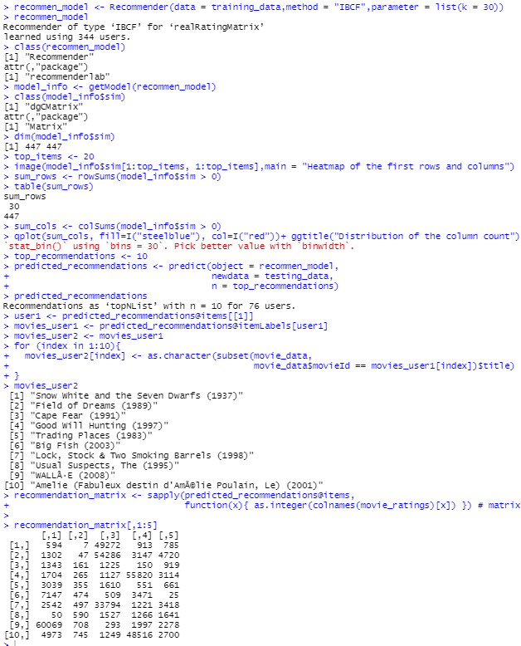
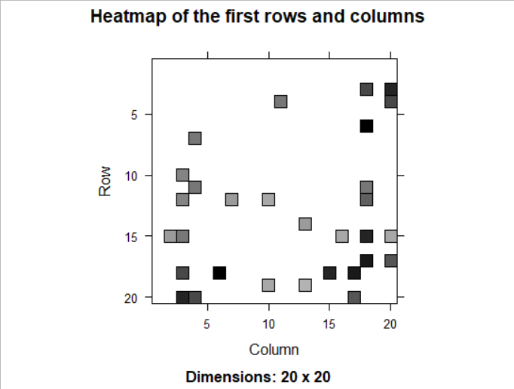
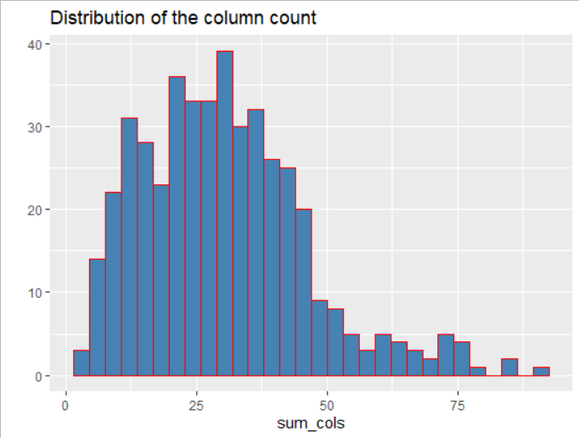

Slide 18
Summary
Finally, we learned how to use machine learning to develop our movie recommended model. We implemented this model using ML algorithm and plotted some visualizations of data and predictions. We learned how to analyse and visualise data in order to recommend movies to the users.

